Slide 1
Collections (Advance)
Name: Sheikh Thanbir Alam
Deg: Senior Software Programmer
Org: Army War Game Center, BD Army

Slide 2
Suggested IDE for C#
Visual Studio (Desktop/Laptop→Click to download)
Try Dot Net (Web→Click to view)
Dot Net Fiddle (Web→Click to view)

Slide 3
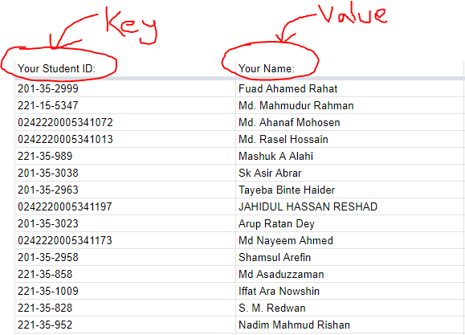
Dictionary

Slide 4
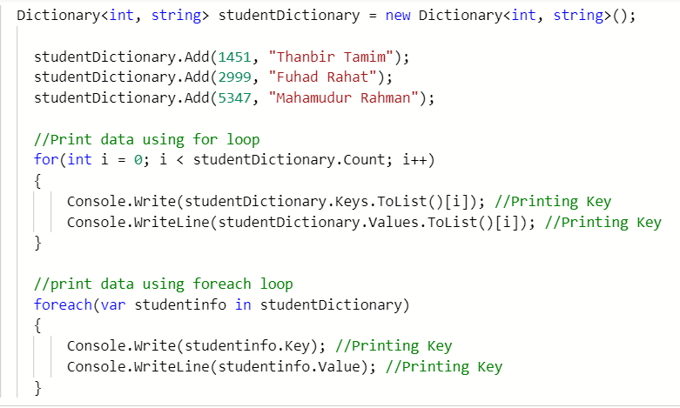
Example:

Slide 5
Tuple
A tuple is a data structure that contains a sequence of elements of different data types.
Question from previous session⇒
Is it possible to keep this whole various data types into List with a single data type?
(Id: 1451, Name: Thanbir, Section: A, Blood: B+)
(Id: 5999, Name: Fuhad, Section: A, Blood: A+)
(Id: 1598, Name: Rana, Section: B, Blood: O+)

Slide 6
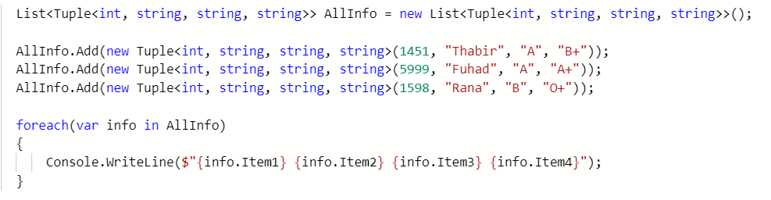
How to keep all previous info into List?

Slide 7

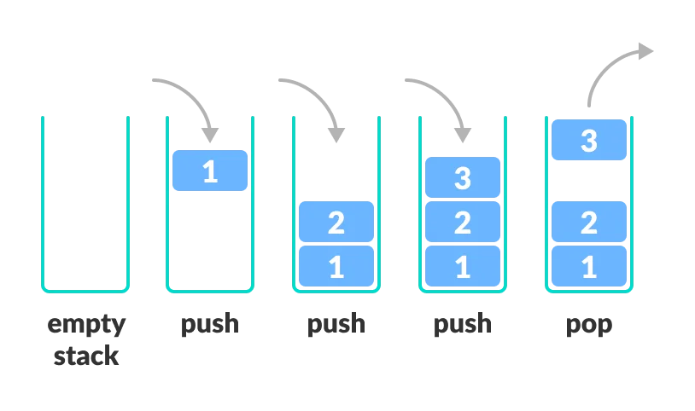
Stack

Slide 8
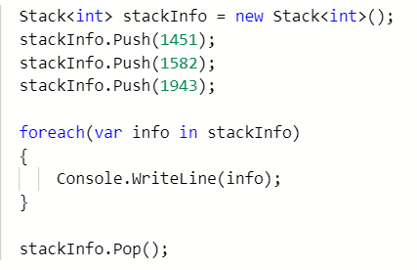
Example

Slide 9
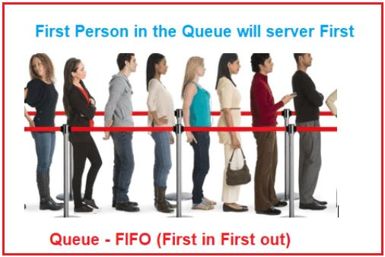
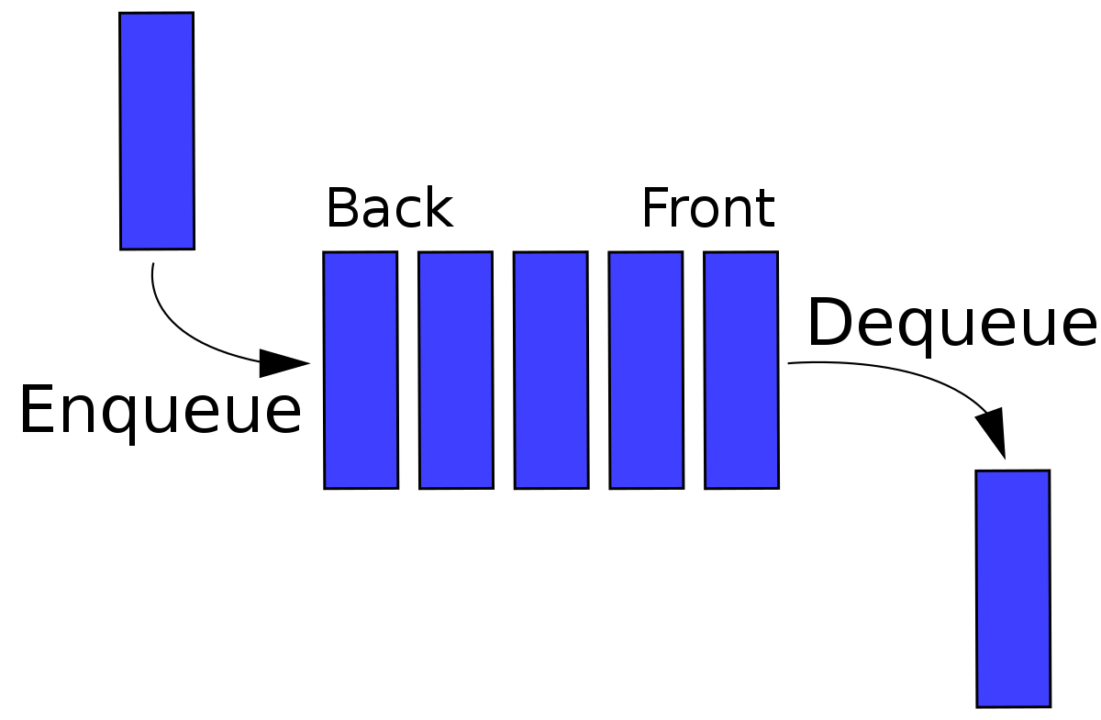
Queue

Slide 10
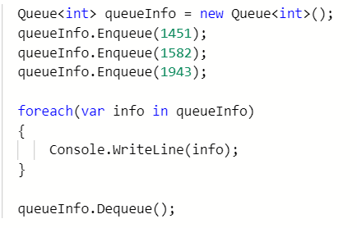
Example

Slide 11


